Slide 1
Execution Context & Variable object (VO)

Slide 2
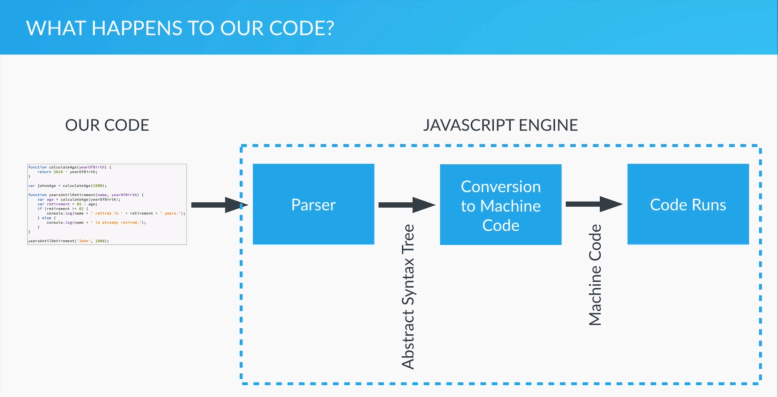

Slide 3
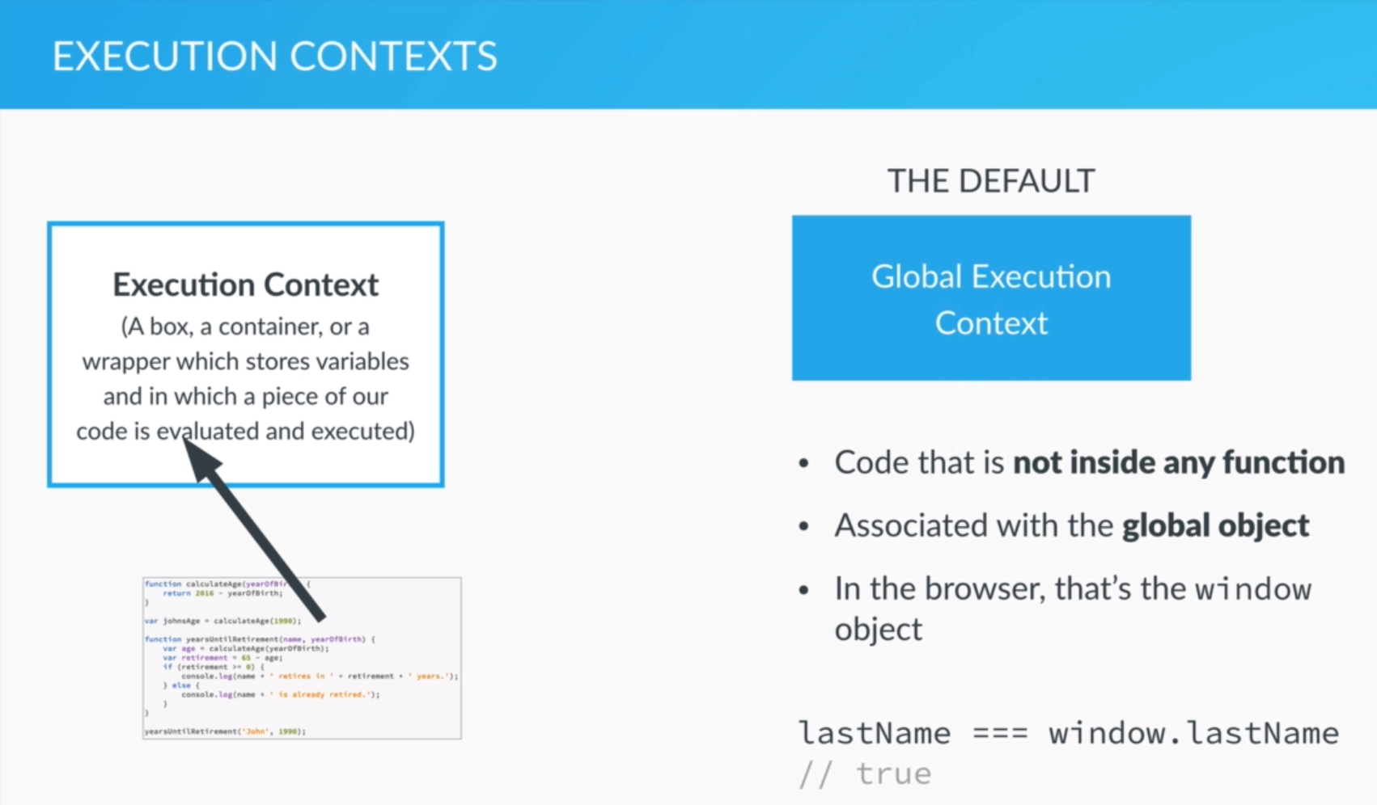

Slide 4
First:
Go to Global Execution Context
(code that not inside function)
For browser, those variable are window object

Slide 5
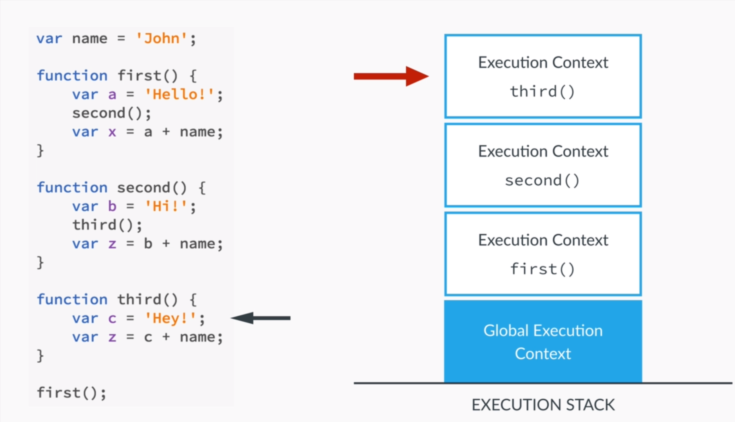

Slide 6
After Global Execution Context:
For first():
It will go to first function
And go to Execution Context of first function
As first() will call second():
So, it go to Execution Context of second function
So do third()
After finish third(), it will go back to second() to finish the code that not yet finished
And then to first ()
Finally, go back to Global Execution Context

Slide 7
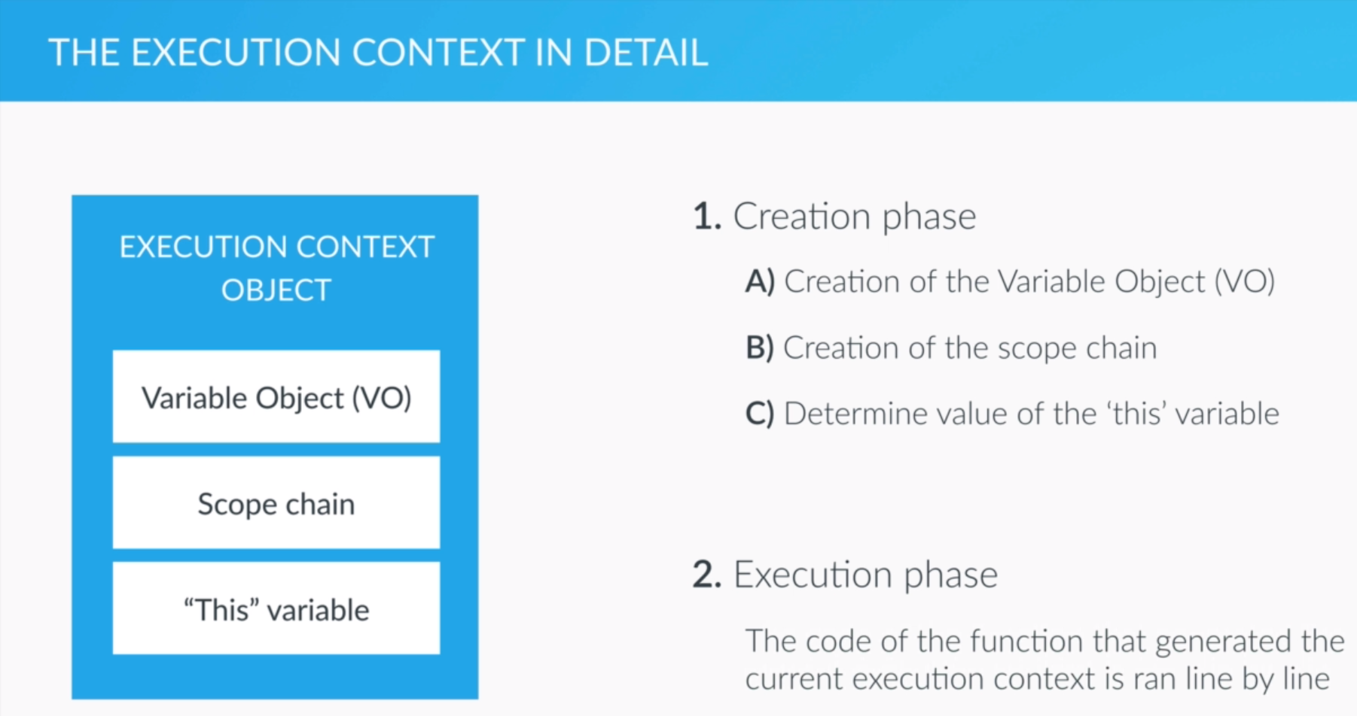

Slide 8
Before Execution:
Must be processed by Creation Phase
Therefore,
Something has to be created before execute

Slide 9
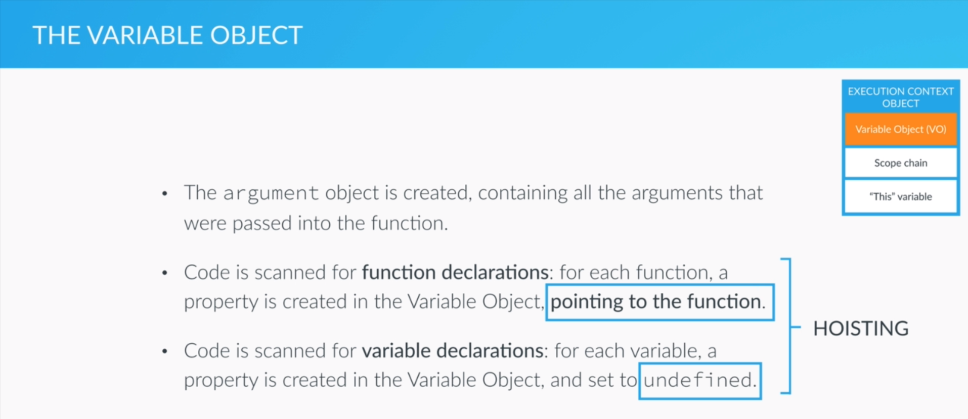

Slide 10
1. Create argument object
2. Scan function declarations
→ Create function property & point to the function
3. Scan variable declaration
Create variable property & set to undefined
Therefore, before execution:
Function property & variable property have been created

Slide 11
Scope Chain

Slide 12
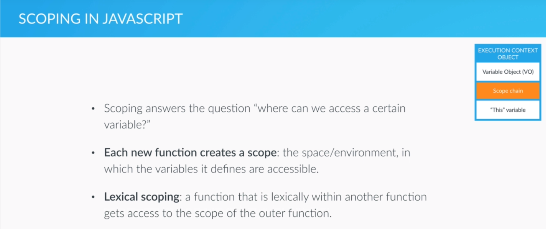

Slide 13
Only new function will create a new scope
e.g. if else → won’t create scope

Slide 14
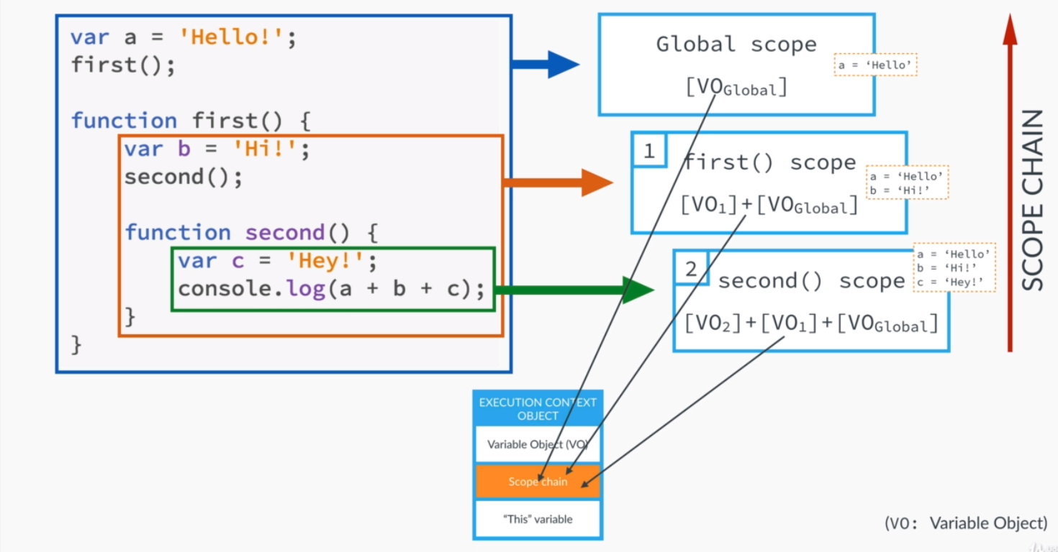

Slide 15
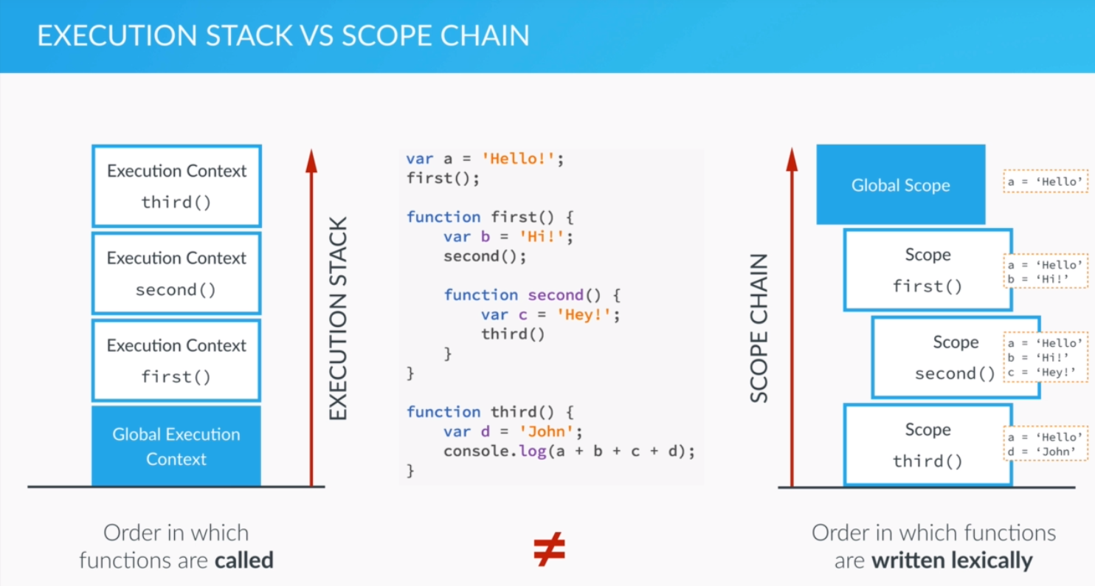

Slide 16
Execution Stack is completely different from Scope Chain
For Execution Stack:
Depends on the time of that function called (time)
For Scope Chain:
Depends on the written format (grammar)
In this case:
Third() scope only can access ‘a’ & ‘d’
(third & global)

Slide 17
“This” Variable

Slide 18
